Slide 1

Markov Decision Process
By Mohsin Ali Mirza

Slide 2
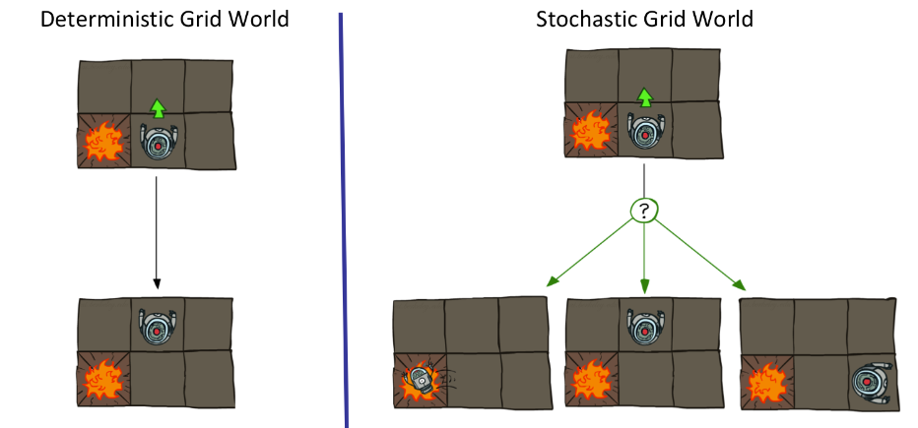
Non-Deterministic Search
(Prob + Search)
Notes:
Add probabilities

Slide 3
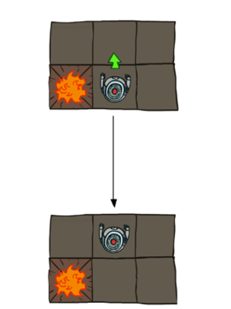
Definitions
States: Observations that are being perceived from the environment to the agent
Actions/Policies: Behavior that an agent Performs
Policy -> 1 Action

Slide 4
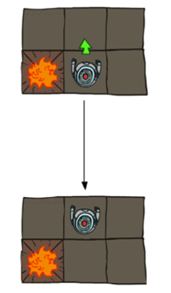
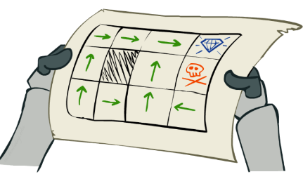
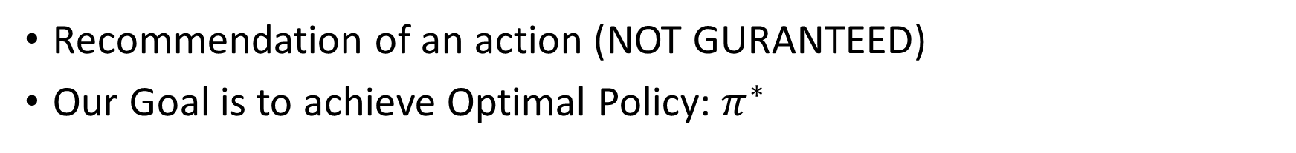
Policies
Dictionary
States
Actions
Policy
Recommendation of an action (NOT GURANTEED)
Our Goal is to achieve Optimal Policy: $π^{∗}$
Explicit Policy
Implicit Policy

Slide 5
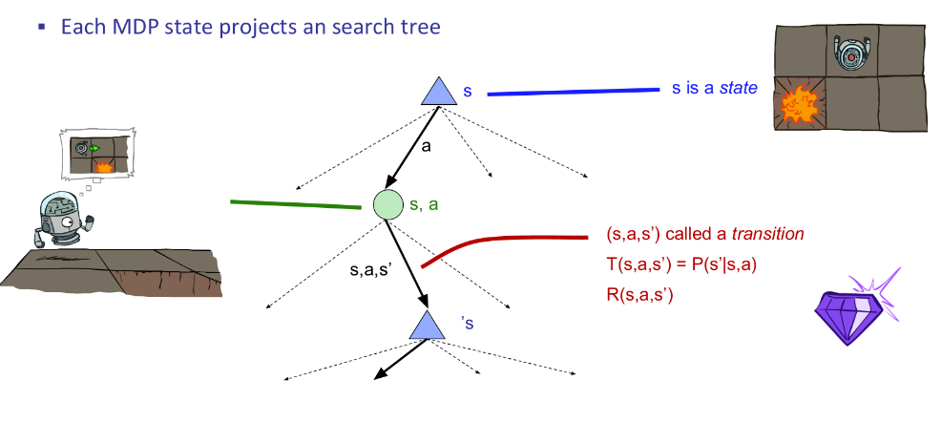

Search Tree

Slide 6
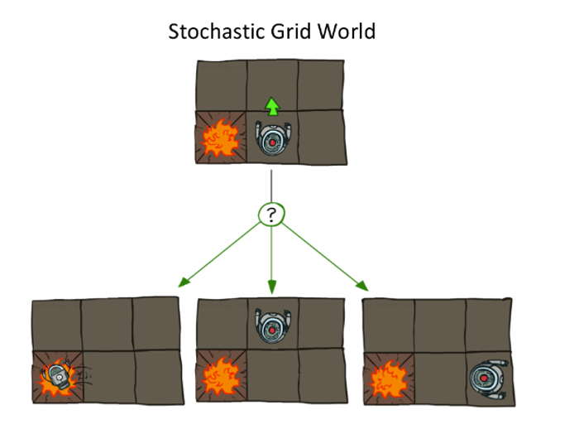
Q States, Chance States, Transitions
Transitions (Probabilities) : T(s,a,s’)->P(s’|s,a)
Q-States: Q(s,a)
Ensuring Non-Deterministic Nature
When a transition is completed
You will get a reward (R)

Slide 7
Search Tree

Slide 8
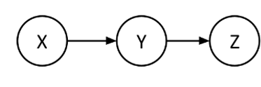

What about Markov Property
Future and Past Events are Independent?
There is no reference between Future and Past State in the equation
$P\left(s′ \right| s,a) or P\left(S_{t+1}=s^{′}\right|S_{t}=s , A_{t}=a)$
Z is Independent X Given Y Z ⫫ X |Y

Slide 9
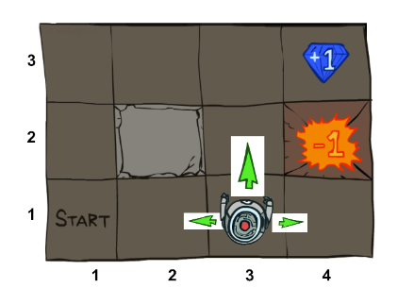
Rewards
Rewards are both good and bad (+ve,-ve)
Living Reward: Reward you get at every step
Terminal Reward: Reward you will get when you terminate or end the game
Terminal Reward
Living Reward
Terminal Reward

Slide 10
Absorbing State / Terminal States
You can’t return from that state once entered.
We use a P(1) to catch the agent and prevent it from moving to any other state from there
In Grid World once we exit the
state only then we will receive
the reward
Absorbing State

Slide 11
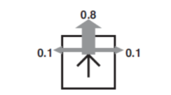
Grid World Explanation
You have 4 actions Up, Down, Right, Left
Probability that If I go in that Desired Action, maybe I’ll go there maybe I’ll stray so
0.8 chance you go in the desired direction
0.1 you will stray left
0.1 you will stray right

Slide 12
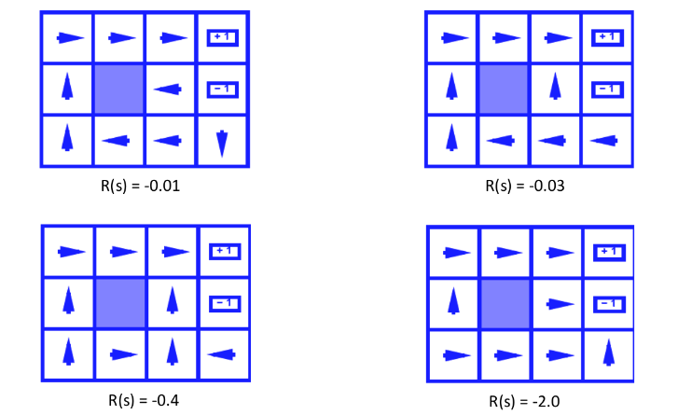
Policy Example
Dictionary
States
Actions
Policy
Transitions
Q-States
Rewards

Slide 13
Search Tree

Slide 14
Solving MDPS
Dictionary
States
Actions
Policy
Transitions
Q-States
Rewards
1. Identify States, Actions, Q-States, Transitions, Rewards
1. Create A Finite State Machine
2. Create the Search Tree
3. Values Calculation?

Slide 15
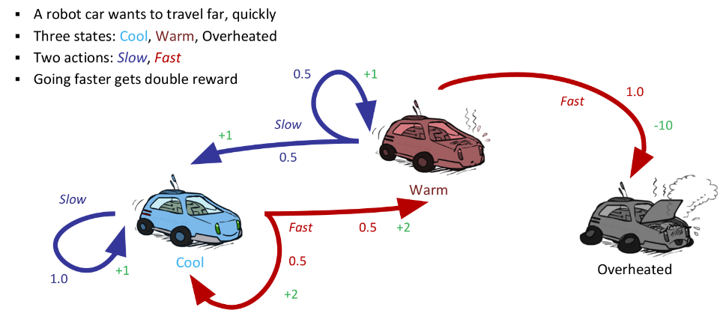
Racing Car Example

Slide 16
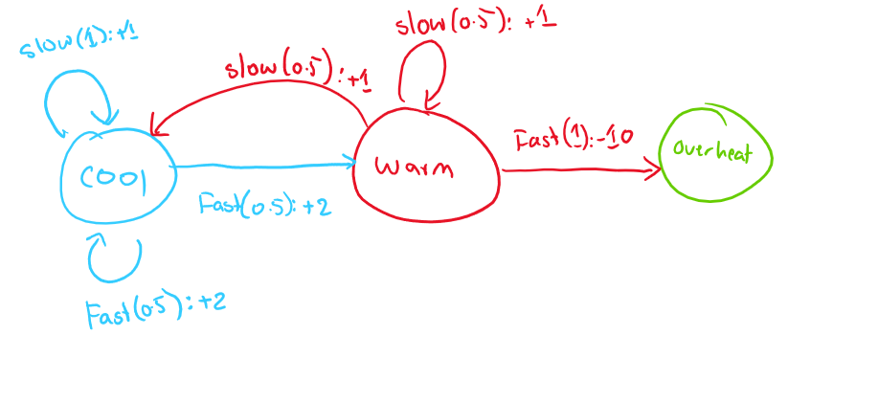
Racing Car Example – State Machine
States:
Actions:
Transitions: Probabilities T(s,a,s’)
Rewards: Written with Probabilities Or Transitions
Absorbing State: ?
Q States: ?
Cool, Warm, Overheat
Slow, Fast
Notes:
Don’t Go next slide and create A State Machine, Also explain why cool is not an absorbing state

Slide 17
Search Tree

Slide 18
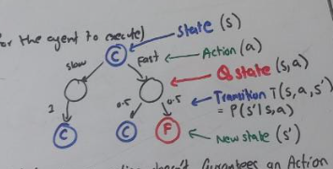
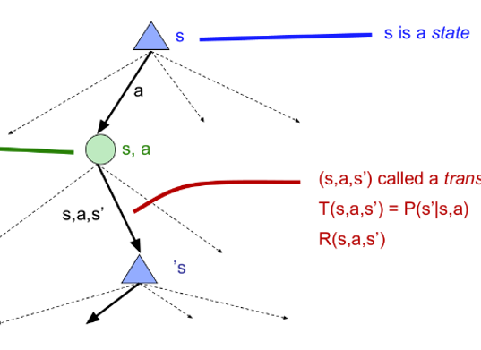
Racing Car Example – Search Tree

Slide 19
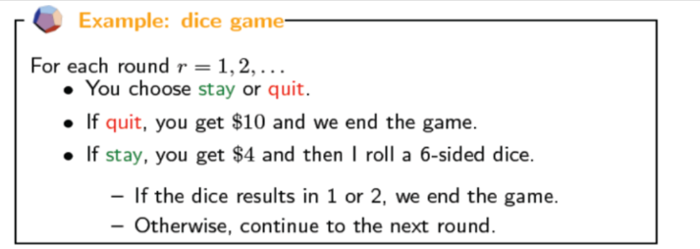
Dice Example
States:
Actions:
Transitions: Probabilities T(s,a,s’)
Rewards: Written with Probabilities Or Transitions
Absorbing State: ?
Q States: ?
In, End
Stay, Quit

Slide 20
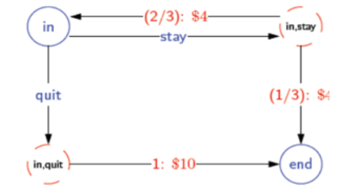
Dice Example – State Machine
States: In, End
Actions: Stay, Quit
T & R: in,stay,in’ = 2/3: $4
in,stay,end’ = 1/3: $4
in,quit,end’ = 1 : $10

Slide 21
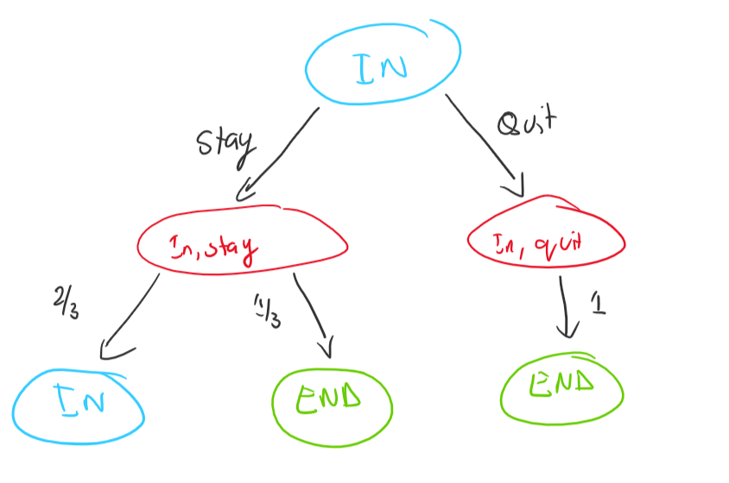
Dice Example – Search Tree

Slide 22
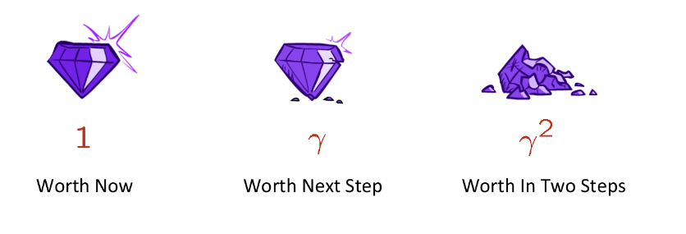

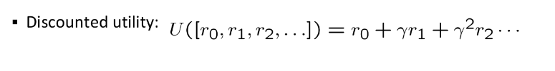
Utilities
Discounted
Utility: Sum of (__________) Rewards
Additive Utility: Sum of Rewards [1 , 2, 3, 4]
Discount Utility: Sum of Discounted Rewards
Now or Later [1,0,0,0] or [0,0,0,1]
Associating Concept of Worth of Money to a machine
Not that good
Better

Slide 23
Infinite Utility
If you have an infinite utility, then it isn’t important which action you will take to achieve that utility.
Solution:
Discounts
Absorbing/Terminal State

Slide 24
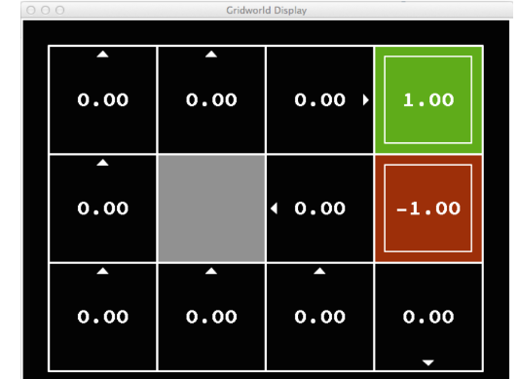
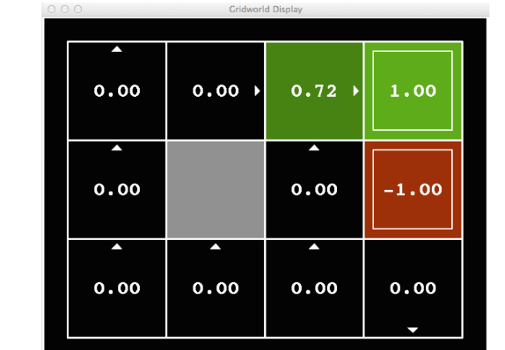
Values
Dictionary
States
Actions
Policy
Transitions
Q-States
Rewards
Utility
Expected Utility from that state for a particular policy
What is the cumulative reward that I can achieve from
that state (Function From State To Number)
V* is known as the optimal Value
V* is the Expected Utility for using optimal Policy from that State

Slide 25
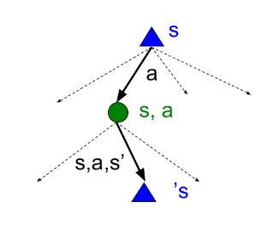
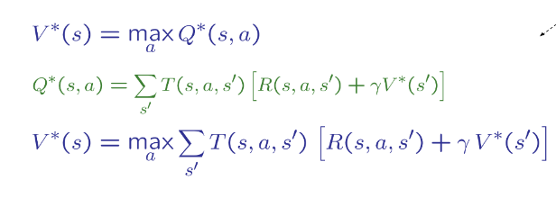
Summarizing Everything: Bellman Equations
Dictionary
States
Actions
Policy
Transitions
Q-States
Rewards
Utility
Values
VERY IMPORTANT
Sum Of Transitions?
Defeats the purpose Non-Deterministic \

Slide 26
Solving MDPS
Dictionary
RESET????
1. Identify States, Actions, Q-States, Transitions, Rewards (DONE)
1. Create A Finite State Machine (DONE)
2. Create the Search Tree (DONE)
3. Values Calculation?
3.1 Value Iteration
3.2 Policy Iteration

Slide 27

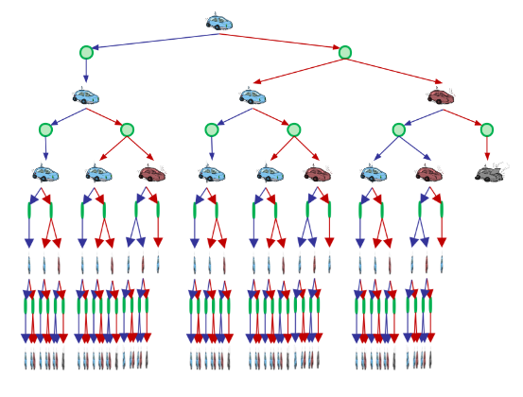
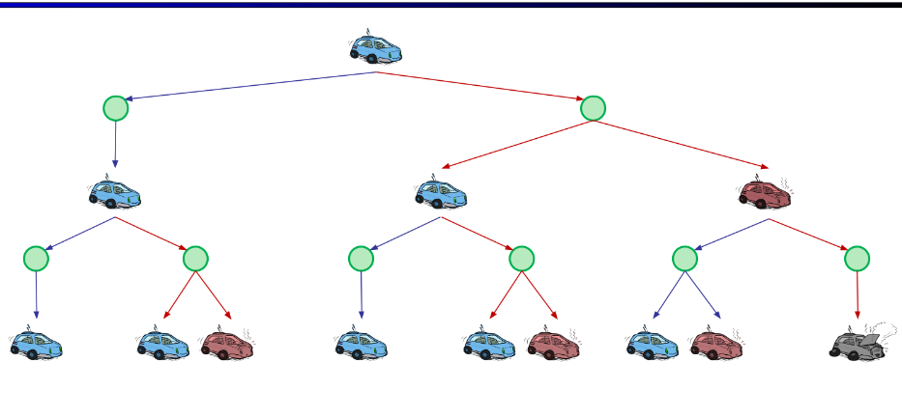
Value Iteration
Equations
Bellman
Why not use the standard bellman equation?
Problem 1: Tree goes Forever
Problem 2: Repetition

Slide 28
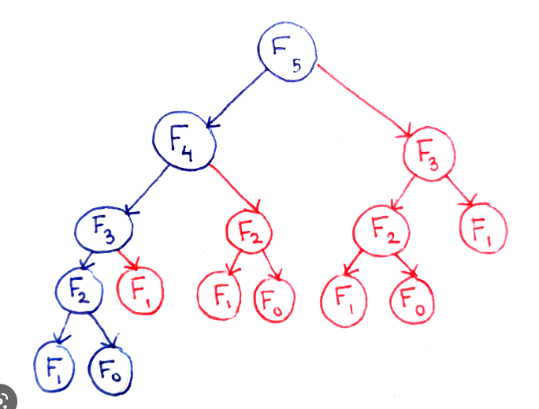
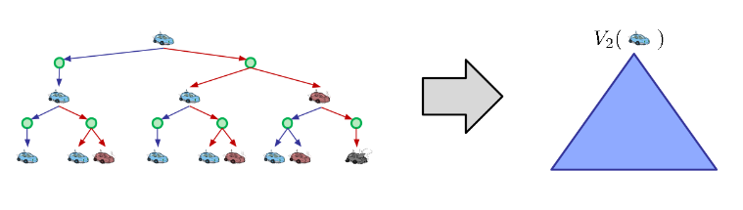

Value Iteration
Key Idea: Use Time Limited Values
A bit similar to Dynamic Programming and Recursions
$V_{k}(s)$ K denotes the time or k steps/actions that can be used for that state s
Order Of Solving

Slide 29
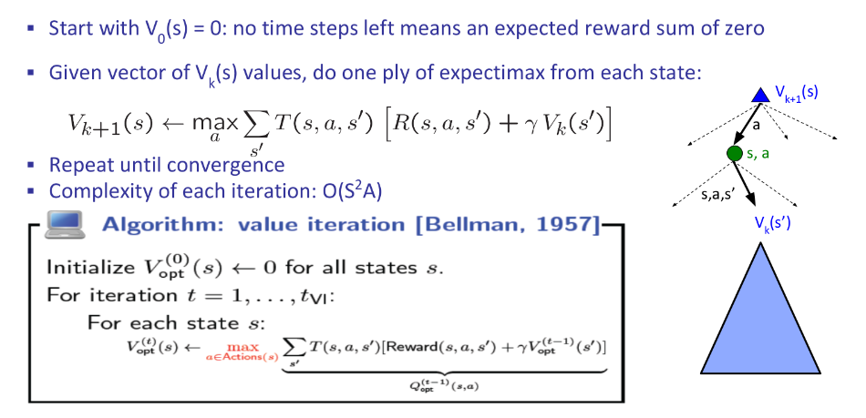
Value Iteration

Slide 30
Solving MDP Using Value Iteration
1. Identify States, Actions, Q-States, Transitions, Rewards (DONE)
1. Create A Finite State Machine (DONE)
2. Create the Search Tree (DONE)
3. Values Calculation?
3.1 Value Iteration (Entire Action Space)
3.2 Policy Iteration

Slide 31

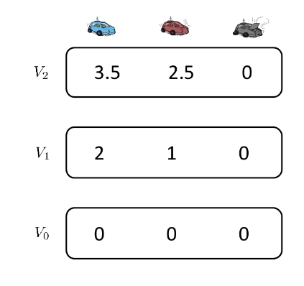
Racing Car Example
Equations
Bellman
Value Itr

Slide 32
Grid World Explanation
You have 4 actions Up, Down, Right, Left
Probability that If I go in that Desired Action, maybe I’ll go there maybe I’ll stray so
0.8 chance you go in the desired direction
0.1 you will stray left
0.1 you will stray right

Slide 33
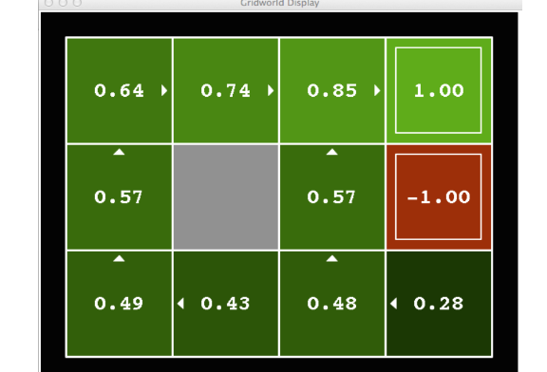
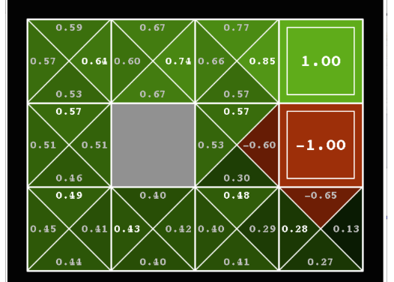
Grid World Example

Slide 34
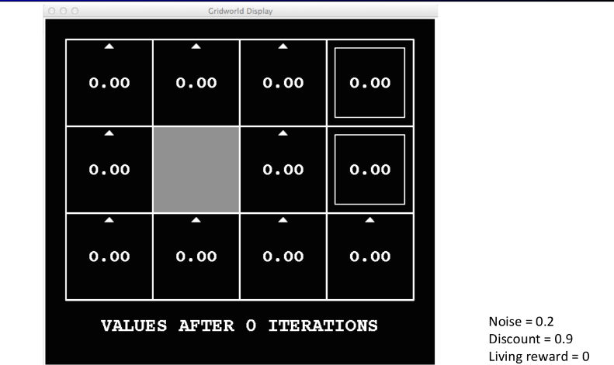
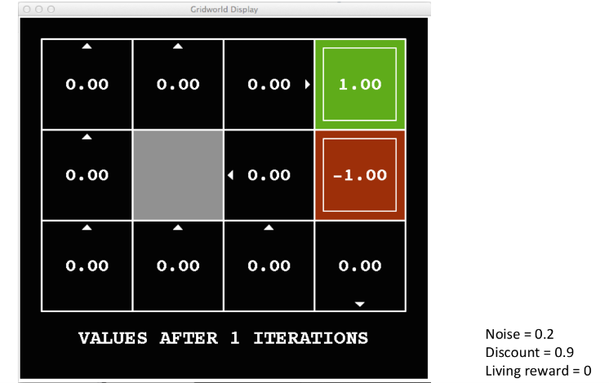
Grid World Example
Equations
Bellman
Value Itr

Slide 35
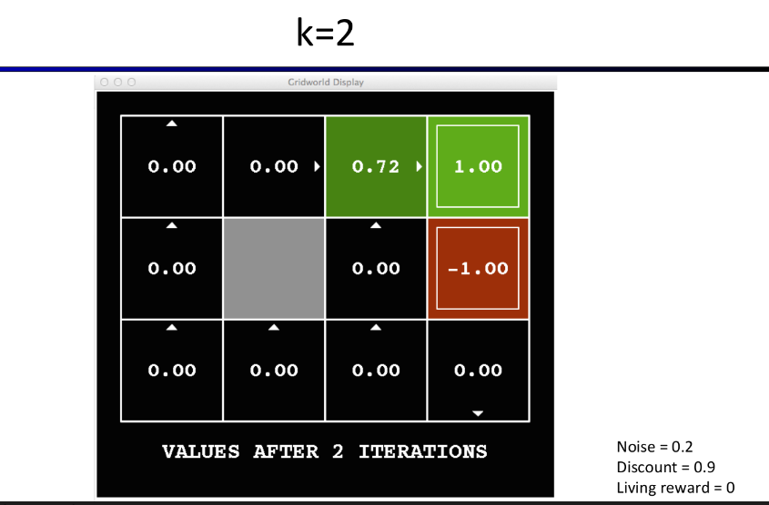

Grid World Example

Slide 36
Grid World Example

Slide 37

Policy Extraction
You are more interested in policies and not in values
Min-Max Example (Policy which leads you to max utility)
Using Value Iteration, you will obtain V* after traversing through each action
How do you obtain Policy from V*?

Slide 38


Policy Extraction
Argmax: Returns an action not a number
Need to Recompute Q value
But would be awesome if you already had the Q values

Slide 39
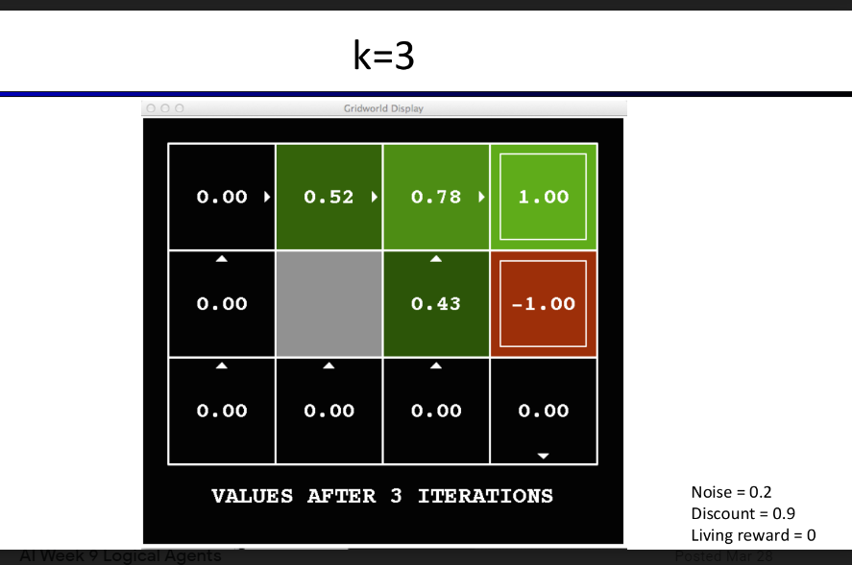
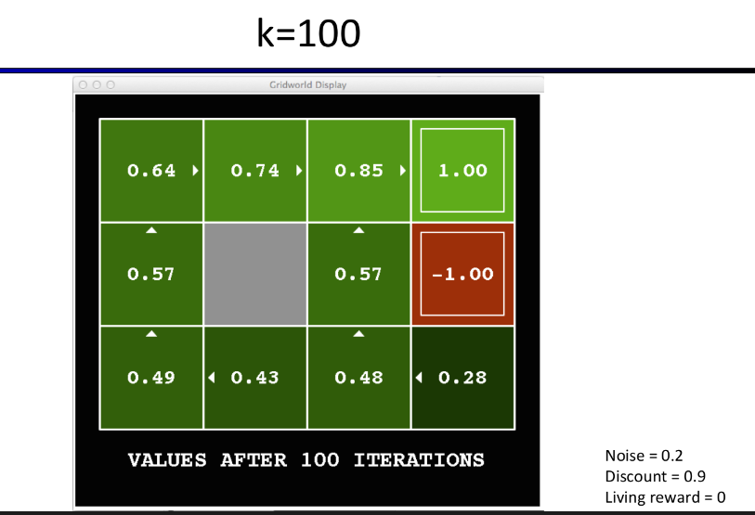
Problems with Value Iteration
It is really slow because you visit each state and each successor and every possible action.
Max value rarely changes after some 1000 iterations
Policies tend to converge faster than values.

Slide 40
Solving MDP Using Value Iteration
1. Identify States, Actions, Q-States, Transitions, Rewards (DONE)
1. Create A Finite State Machine (DONE)
2. Create the Search Tree (DONE)
3. Values Calculation?
3.1 Value Iteration (DONE)
Policy Extraction
3.2 Policy Iteration

Slide 41
Policy Iteration
Equations
Bellman
Value Itr
Policy Extraction
Step 1: Policy Evaluation (Can be used on its own)
How good is a policy?
Step 2: Policy Improvement
Update the policy if a better policy is found

Slide 42
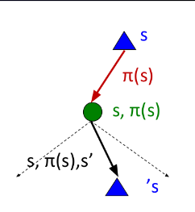
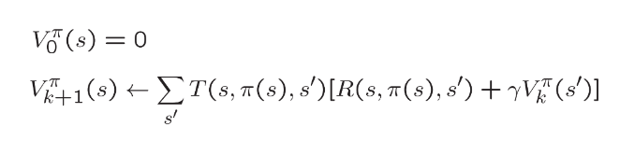
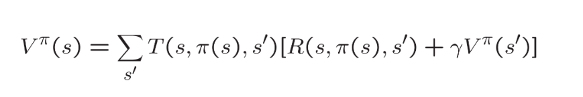
Policy Evaluation
Equations
Bellman
Value Itr
Policy Extraction
For some fixed policy which may not be optimal
Calculate how good or bad that policy is? (Value)
Uses the idea of K steps, very similar to Value Iteration
but no max

Slide 43
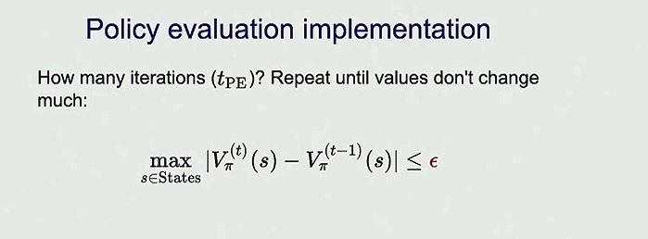
SKIP This

Slide 44


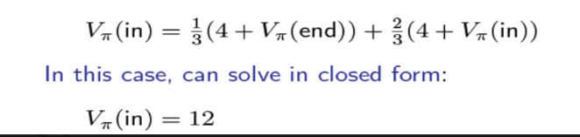
Dice Example
Equations
Bellman
Value Itr
Policy Extraction
Policy Evaluation
For some Fixed Policy

Slide 45
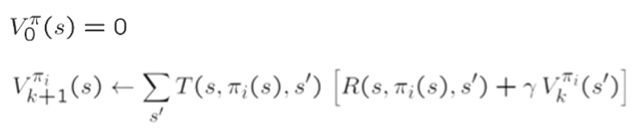



Policy Iteration
Equations
Bellman
Value Itr
Policy Extraction
Policy Evaluation
Step 1: Policy Evaluation: How good is a policy?
Step 2: Policy Improvement: Update Policy using 1-step lookahead

Slide 46
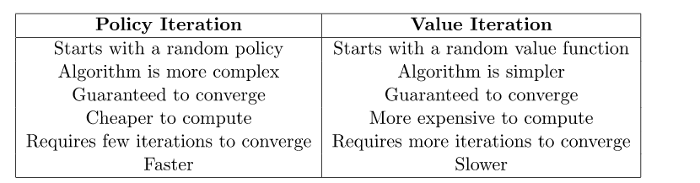
Policy Iteration Vs Value Iteration
Policy Iteration
Compute Value for a Fixed Policy
Evaluate that policy (Compute Value)
Improve the policy if possible(Policy Extraction)
Value Iteration
Compute Value for all actions
Policy extraction

Slide 47
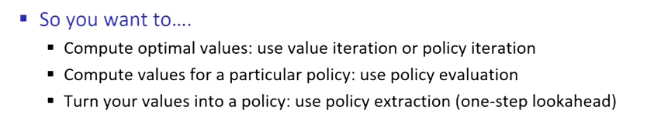
Summary

Slide 48

Equations & Definitions Covered
Equations
Bellman
Value Iter
Policy Extraction
Policy Evaluation
Policy Improvement
Dictionary
States
Actions
Policy
Transitions
Q-States
Rewards
Utility
Values

